Slide 1
Logical and probabilistic reasoning
Based on Pedro Domingos’ slides

Slide 2
Overview
Motivation
Background
Markov logic networks
Inference in MLNs
Learning MLNs
Experiments
Discussion

Slide 3
Questions
Is it possible to combine the full power of first-order logic and probabilistic graphical models in a single representation?
Is it possible to reason and learn
  efficiently in such a representation?

Slide 4
Markov Logic Networks
Syntax: First-order logic + Weights
Semantics: Templates for Markov nets
Inference: KBMC + MCMC
Learning: ILP + Pseudo-likelihood
Special cases: Collective classification,
link prediction, link-based clustering,
social networks, object identification, etc.

Slide 5
Overview
Motivation
Background
Markov logic networks
Inference in MLNs
Learning MLNs
Experiments
Discussion

Slide 6
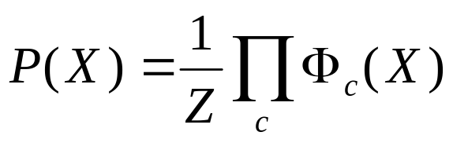
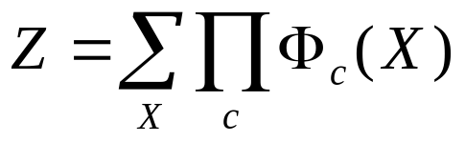
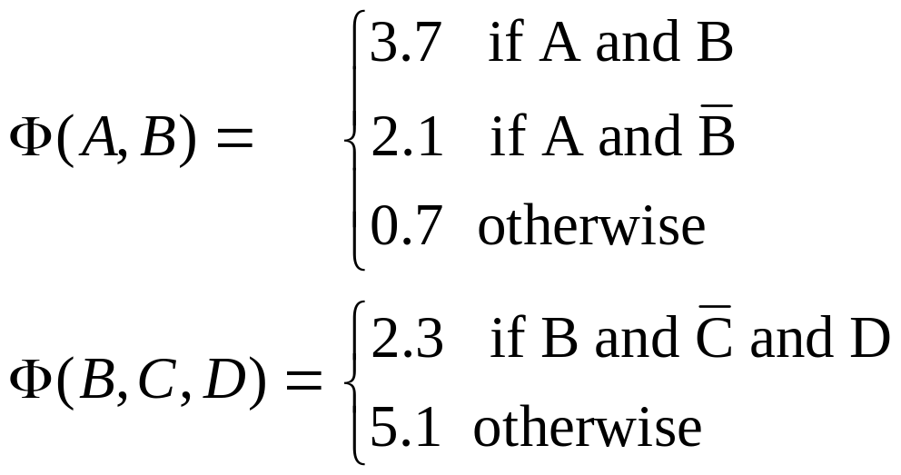
Markov Networks
Undirected graphical models
A
B
C
D
Potential functions defined over cliques

Slide 7
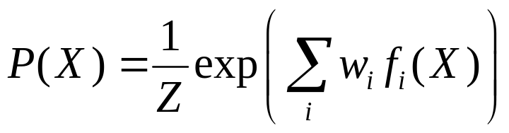
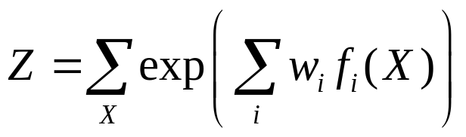
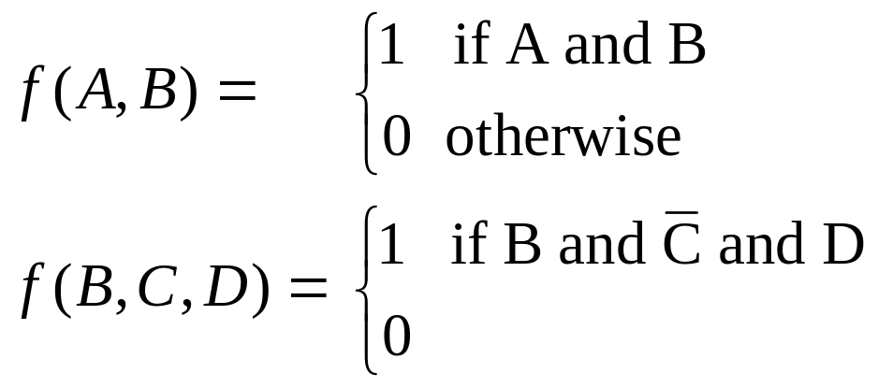
Markov Networks
Undirected graphical models
A
B
C
D
Potential functions defined over cliques
Weight of Feature i
Feature i

Slide 8
First-Order Logic
Constants, variables, functions, predicates
E.g.: Anna, X, mother_of(X), friends(X, Y)
Grounding: Replace all variables by constants
E.g.: friends (Anna, Bob)
World (model, interpretation):
Assignment of truth values to all ground predicates

Slide 9
Example of First-Order KB
Smoking causes cancer
Friends either both smoke or both don’t smoke

Slide 10
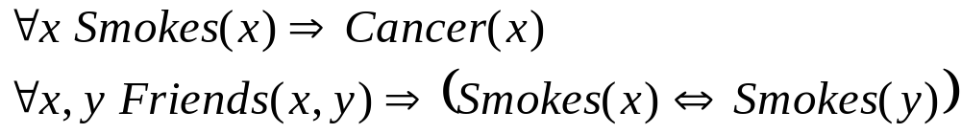
Example of First-Order KB

Slide 11
Overview
Motivation
Background
Markov logic networks
Inference in MLNs
Learning MLNs
Experiments
Discussion

Slide 12
Markov Logic Networks
A logical KB is a set of hard constraints
on the set of possible worlds
Let’s make them soft constraints:
When a world violates a formula,
It becomes less probable, not impossible
Give each formula a weight
(Higher weight ⇒ Stronger constraint)

Slide 13
Definition
A Markov Logic Network (MLN) is a set of pairs (F, w) where
  F is a formula in first-order logic
  w is a real number
Together with a set of constants,
it defines a Markov network with
  One node for each grounding of each predicate in the MLN
  One feature for each grounding of each formula F in the MLN, with the corresponding weight w

Slide 14

Example of an MLN
Suppose we have two constants: Anna (A) and Bob (B)
Smokes(A)
Smokes(B)
Cancer(A)
Cancer(B)

Slide 15
Example of an MLN
Suppose we have two constants: Anna (A) and Bob (B)
Friends(A,B)
Friends(A,A)
Smokes(A)
Smokes(B)
Friends(B,B)
Cancer(A)
Cancer(B)
Friends(B,A)

Slide 16
Example of an MLN
Suppose we have two constants: Anna (A) and Bob (B)
Friends(A,B)
Friends(A,A)
Smokes(A)
Smokes(B)
Friends(B,B)
Cancer(A)
Cancer(B)
Friends(B,A)

Slide 17
Example of an MLN
Suppose we have two constants: Anna (A) and Bob (B)
Friends(A,B)
Friends(A,A)
Smokes(A)
Smokes(B)
Friends(B,B)
Cancer(A)
Cancer(B)
Friends(B,A)

Slide 18
More on MLNs
Graph structure: Arc between two nodes iff predicates appear together in some formula
MLN is template for ground Markov nets
Typed variables and constants greatly reduce size of ground Markov net
Functions, existential quantifiers, etc.
MLN without variables = Markov network
(subsumes graphical models)

Slide 19
MLNs Subsume FOL
Infinite weights ⇒ First-order logic
Satisfiable KB, positive weights ⇒
Satisfying assignments = Modes of distribution
MLNs allow contradictions between formulas
How to break KB into formulas?
  Adding probability increases degrees of freedom
  Knowledge engineering decision
  Default: Convert to clausal form

Slide 20
Overview
Motivation
Background
Markov logic networks
Inference in MLNs
Learning MLNs
Experiments
Discussion

Slide 21
Inference
Given query predicate(s) and evidence
1. Extract minimal subset of ground Markov
network required to answer query
2. Apply probabilistic inference to this network
(Generalization of KBMC [Wellman et al., 1992])

Slide 22
Grounding the Template
Initialize Markov net to contain all query preds
For each node in network
  Add node’s Markov blanket to network
  Remove any evidence nodes
Repeat until done

Slide 23
Example Grounding
Friends(A,B)
Friends(A,A)
Smokes(A)
Smokes(B)
Friends(B,B)
Cancer(A)
Cancer(B)
Friends(B,A)
P( Cancer(B) | Smokes(A), Friends(A,B), Friends(B,A))

